Slide 1



Mindtrek 2026, Tampere, 6th of October, 2026
Sovereign
by habit
20 years of self-hosting from source
on European servers
Rolle Laukkarinen
Founder and CTO, Digitoimisto Dude Oy
→ rolle.social

Slide 2
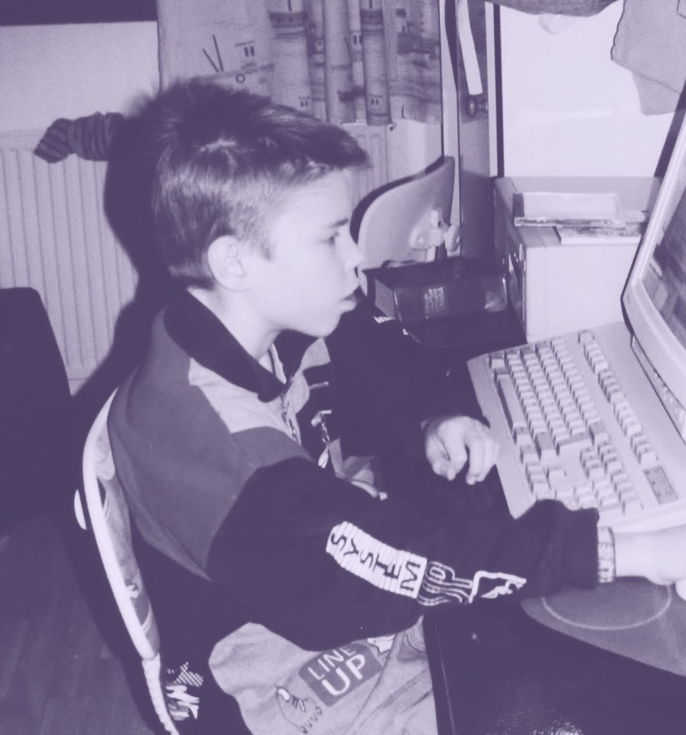

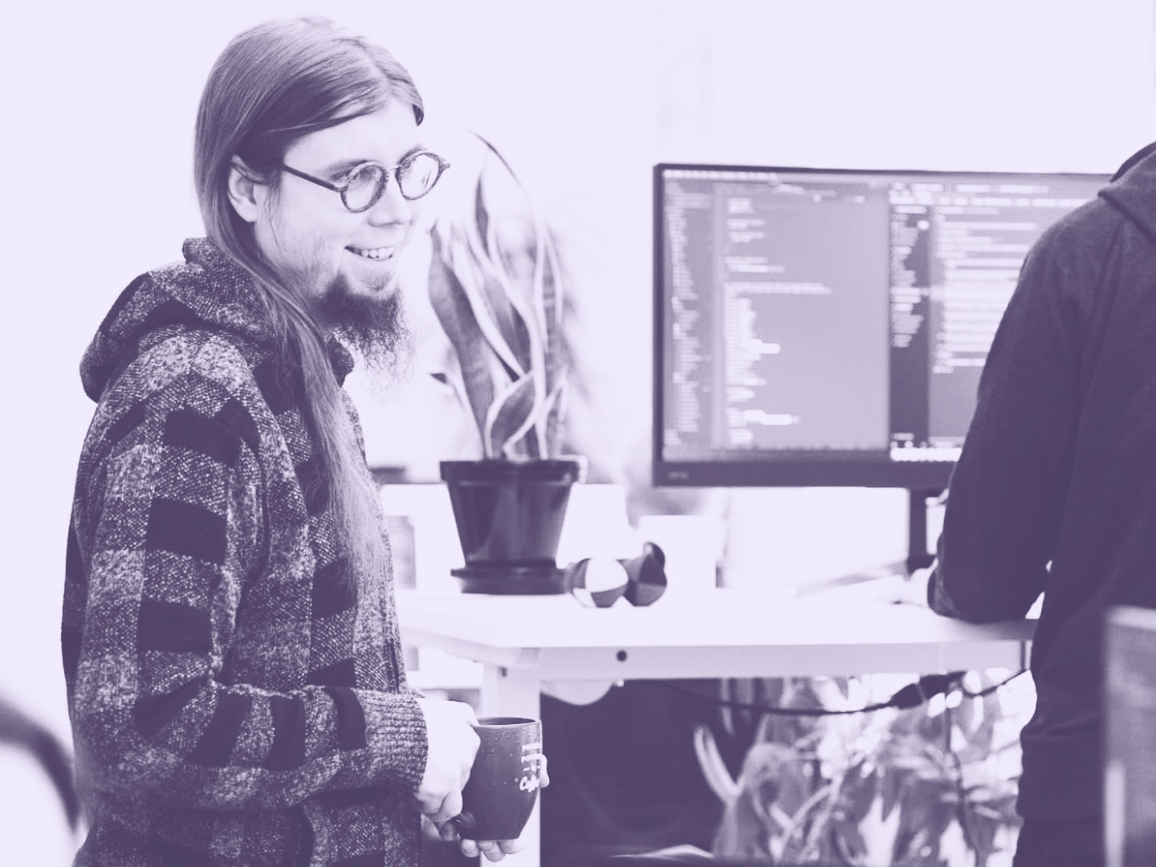

About Rolle
Founder and CTO of Digitoimisto Dude Oy. Code soon 30 years, WordPress since 2005, online since 1999. Accessibility, open source, Linux servers, and building my own tools. Free time: running, bilingual family, knows sign language.
Contributing to WordPress and open source since we founded Dude in 2013: 71 open source repositories on GitHub, including air-light, our starter theme with over 1100 stars. Self-hosting as much as we can.
Sovereign by habit

Slide 3


What I mean by server and source
Server
Source
A computer the outside world can reach online.
A file I can read and study myself, without barriers.
Sovereign by habit
Notes:
Let’s start by the definitions. Two words run through the whole talk.
A server is a computer the outside world can reach online. Nothing more.
Source is a file I can read and study myself, without barriers between me and it.

Slide 4




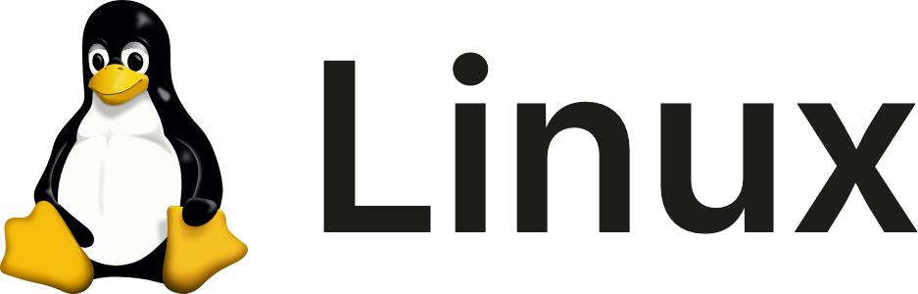
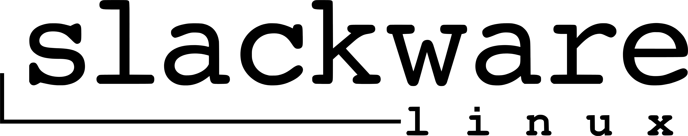

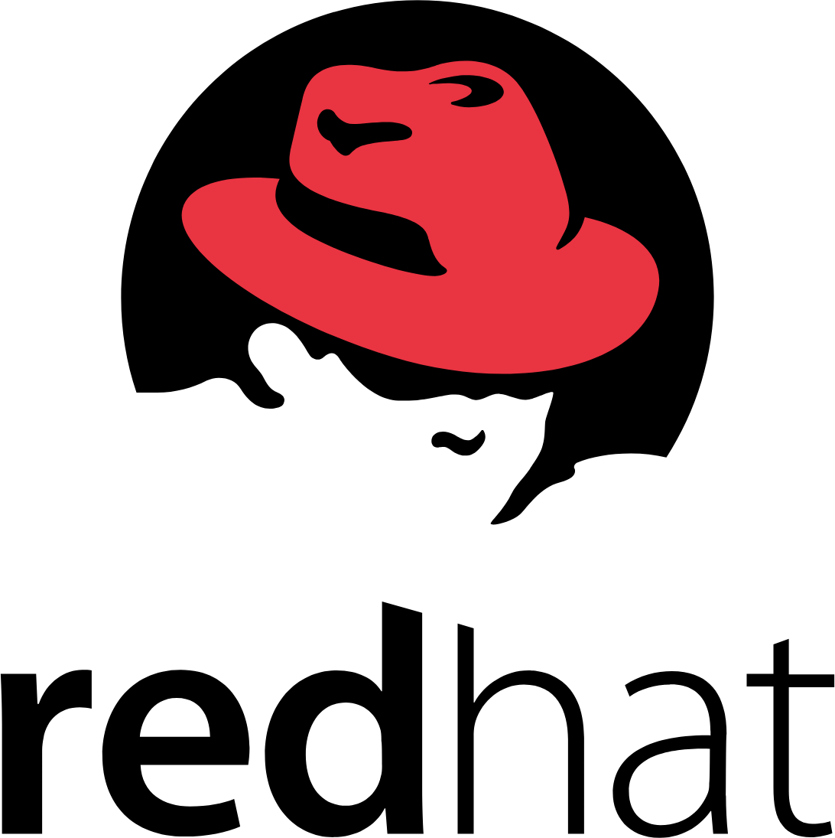
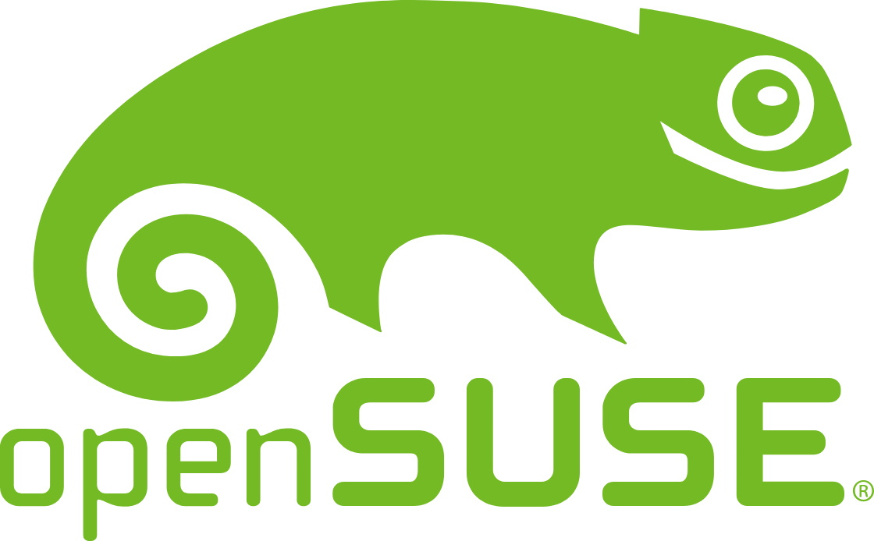

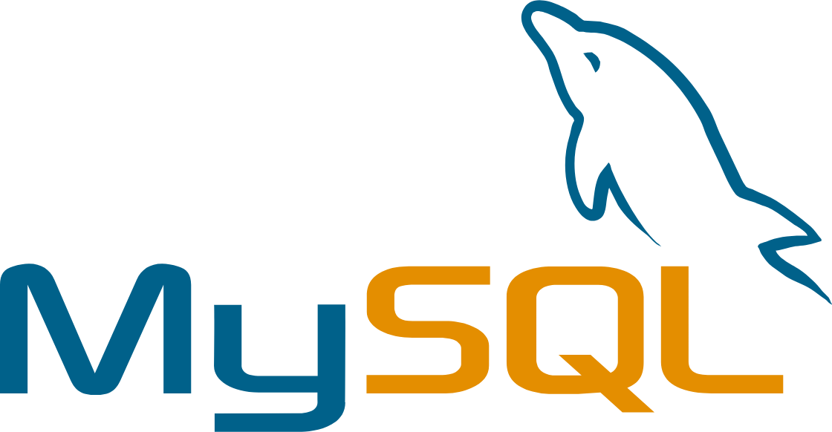

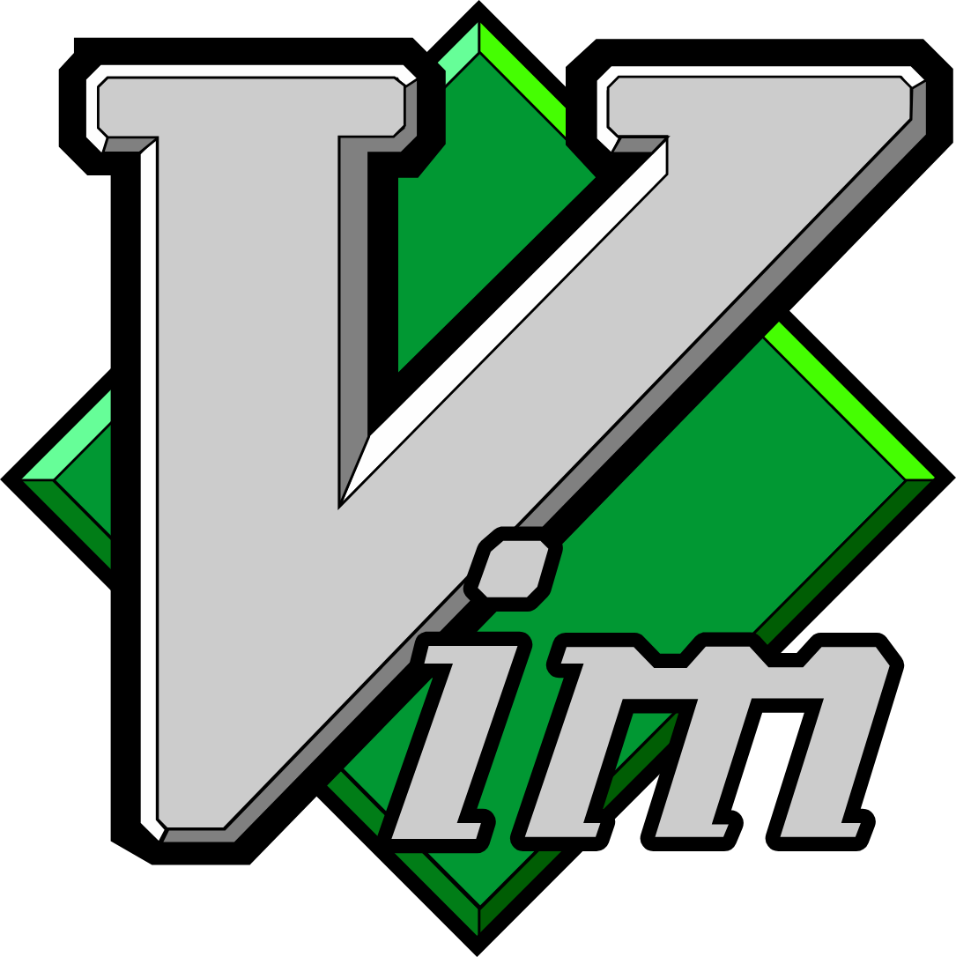

When some of us started,
this was the whole stack
Sovereign by habit
Notes:
Commodore at home, GNU, BSD and Perl, the first Linux distributions on CDs, Apache, MySQL and PHP, and Vim. For some of us in the room, it all started here.

Slide 5
My first servers ran at home
Dynamic DNS
The problems
A script updated the DNS the moment my home IP changed.
It ate the family bandwidth, upload was tiny, and it hummed in a wardrobe.
Renting servers
Still at home
Anything that needed bandwidth moved out of the wardrobe to rented servers.
My IoT still runs at home on my own hardware, and I still tinker and self-host at home.
Sovereign by habit
Notes:
Before any company, my servers were at home. A box with a dynamic IP, and a script updating the DNS record the moment the address changed.
I liked it: my own hardware, my own files, nothing between me and the machine.
It had its problems. It ate the family bandwidth, upload speeds were tiny back then, and we had no spare room, so it lived in a wardrobe and hummed. My wife was not a fan.
So anything needing bandwidth moved out of the wardrobe to rented servers in a datacentre. The IoT at home still runs on my own hardware.
Before then: KDE at 8 years old on the family's Red Hat based Linux, Mandrake dual-booted on my sister's PC in 1998, and an IRC shell account on TNNet at school.

Slide 6


































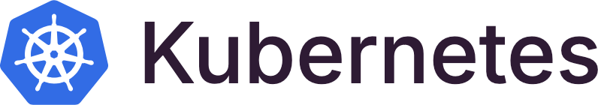































































Sovereign by habit
Notes:
Roughly the server and hosting landscape today. Clouds and platforms, containers and orchestration, databases, monitoring, CI and everything in between. And somewhere in there is Skynet, if you spotted it.

Slide 7












































































Sovereign by habit
Notes:
And these are the ones I actually use. Everything lit is in daily use, at Dude or at home. The half-lit ones I use only for some things. The rest I have tried, read about or chosen not to use.
Most of the lit logos are open source.

Slide 8
I want to see
the filesystem
Every system runs inside some box. I want to be able to open mine and read it.
Sovereign by habit
Notes:
I understand why containers exist. They isolate things and make them easy to repeat, and I use them for some things.
But for me, plain files and source code on a server I can log into is the most natural way to work. Nothing is hidden behind an image. If something breaks, I open the file and read it.
And to be fair, everything is contained at some level: a container, a virtual machine, a rented server in somebody's datacentre. The question for me has always been how much of the box I can see into.
I know these servers are set up one by one. I will come back to the problems later.

Slide 9








From partners
to our own server
2013
Client sites on hosting partners' servers.
Agency
Control panel
Jail
Their server
Apache
Jails and control panels stood between us and the server.
2015
Our first own VPS, to run the latest nginx and HHVM-FastCGI.
Agency
SSH
Our own VPS
nginx
Sovereign by habit
Notes:
I wanted a purely command-line way of working. The first VPS ran HHVM. It kept crashing, so I wrote a cron script to restart it. Doing operations ourselves started there.

Slide 10









Choosing providers, and leaving them
2015
2016
2016
2016
Since 2016
2026
A US cloud
In France
The outage
The move
The rock cave
Today
The first VPS.
2 web, 2 database
and 1 file server.
Every client
site hangs.
Every site moved
to a local data
center in Finland.
A datacentre in a
former army rock
cave, on wind power.
Still on European
servers, data on sovereign ground.
Sovereign by habit
Notes:
It started in September 2016 with slow nights and short drops, week after week. The provider's support found nothing.
Then one Monday morning every client site hung, and nobody in France could be reached. Weeks later a report arrived in French. As far as my school French could tell, an excavator had cut the network.
In mid-October 2016 we moved every site to a local data center in Finland.
One thing saved us: we ran DNS for most of our clients ourselves. Without it, the move would have taken days.

Slide 11








The fleet today
nginx
Analytics
PHP-FPM
MariaDB
Docs
Valkey
Security layers
CRM
Linux
Dozens of clusters
14 people
Built for purpose
Own your services
Self-hosted Linux and virtualization.
A web agency with its own sysop team.
Each server is set up for its use, with nothing extra installed.
Analytics, docs, CRM, and other software run on our own servers.
Sovereign by habit
Notes:
Deploys go from Git with Capistrano. Larger sites get a cluster with HAProxy, Galera and lsyncd. The self-hosted services are Plausible, Outline and Twenty.

Slide 12











From source and from upstream
Module source
Built here
Our server
Brotli, cache purging, GeoIP…
Against the running
nginx version.
nginx and modules
PHP
Upstream repositories
MariaDB
Distribution packages
nginx.org mainline, PPAs, MariaDB.
Applications
FOSS
Distribution packages
Our own configuration
Everything else comes from
the distribution.
Every configuration file is ours,
with our own defaults.
Sovereign by habit
Notes:
The title says from source, so to be exact: most software comes from upstream, and a few modules are compiled by us. The point: unmodified upstream software, configured manually, on a server we can read.

Slide 13


The package broke, source kept running
Read the running build
Build the module against it
nginx -v
curl -O nginx.org/download/nginx-$V.tar.gz
nginx -V 2>&1 | grep configure
tar xzf nginx-$V.tar.gz && cd nginx-$V
./configure <same arguments> \
--add-dynamic-module=../ngx_cache_purge
make modules
Canonical’s nginx security update made nginx crash with external modules. Our nginx comes from nginx.org mainline, with modules built from source against it, and it kept running.
Sovereign by habit
Notes:
On the 9th of June 2026, Ubuntu released a security update for nginx, USN-8398-1. It made nginx crash with a segfault whenever external modules were loaded, and dozens of web services went down. Ubuntu reverted the fix in USN-8398-2 and apologised for the inconvenience.
Our servers kept running. We run nginx from nginx.org mainline and build the modules from source against the running version, so the Ubuntu update never touched them.
Ubuntu's nginx is also much older. Mainline always has the latest.

Slide 14











Self-hosting needs standards too
Built from source
Where the details matter.
Ansible playbooks
One standard
Written down
The same setup on every server.
Same rules for every
kind of setup.
Servers and code are
both documented.
Docker
For some services, where it fits.
Sovereign by habit
Notes:
Running things from source does not mean every server is a snowflake. We use Ansible playbooks a lot, and Docker for some services, even where parts are built from source.
Support more than one way of doing things, and agree on how each one is done. And write it down, for servers and for code alike.
I used to run Vagrant for years, to self-host my development environment too. A story for another time.
The everyday work runs on its own: monitoring and heartbeats, backups, certificate renewals and cleanups on a schedule. Updates are the one step a person reviews before they go live.

Slide 15
Self-hosting takes more work
—
Most of the work goes into compiling and configuring.
—
Servers drift apart without fleet control.
—
Fixes happen manually first and end up in scripts later.
—
Knowledge stays with a few people unless it is written down.
—
AI now speeds up the configuring and the scripting.
Sovereign by habit
Notes:
Most of the work goes into compiling and configuring new software. Updates themselves are scripted.
Servers drift apart without fleet control. Fixes happen manually first and end up in scripts later. And the knowledge stays with a few people unless someone writes it down.
AI makes the slow parts faster. It helps with build options, configuration files and the scripts themselves.

Slide 16
Why we still do it
—
Every layer can be read, down to the source code.
—
A crash can be traced from the log to the source.
—
Portability and owning your data. In 2016 we moved every site to another provider.
—
No vendor lock-in.
Sovereign by habit
Notes:
Every layer can be read. When something crashes, I can follow it from the log down to the source code, like with the nginx modules.
When a provider failed us in 2016, we could move every site somewhere else.

Slide 17






Own servers and the cloud
Own servers
Cloud
Code and data
We can open every layer, and moving to another provider means copying files and databases.
Code and data
The provider handles hardware failures, failover and scaling.
Runtime
Runtime
Operating system
Operating system
We patch, monitor and fix everything ourselves, also at night.
When the platform breaks, we wait. An American company's EU region still falls under US law.
Network
Network
Hardware
Hardware
We are in control
The provider is in control
Sovereign by habit
Notes:
Most of you know these already, so here is the short version.
The US CLOUD Act from 2018 lets US authorities request data from American companies wherever the data is stored. A European region does not change it.

Slide 18









Own your data
Read it
and know where it lives
Your data
Back it up
FOSS, analytics, documents, CRM all live on servers you own and control, with back ups.
Move it
Sovereign by habit
Notes:
Own your data. My mantra for years.

Slide 19








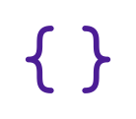
True portability, move any time
Open source software
Another provider
Copy the files and databases, and go.
Your own servers
Any tool, with AI
With a proper API, an MCP server can
move data in any direction.
Your own data
Nobody watching
Open APIs
Nobody else reads the data
on your own servers.
Sovereign by habit
Notes:
Portability is a huge part of sovereignty. When everything runs on open source, on our own servers, with our own data and open APIs, we can move anywhere we want, any time we want. Lock-in is the real question.
In the AI era the same goes for any service with a proper API. Anyone can write an MCP server for it, and data can move in any direction at any time. Self-hosting does not become less important. It becomes more important.
And there is privacy. Nobody else reads the data on our own servers.
The 2016 move worked because we kept DNS in our own hands.

Slide 20
We still depend on others
DNS and CDN
Email
Cloudflare and similar for DNS and caching.
Mailgun, SendGrid, large services for reputation. Delivery depends on the large mail providers.
Code and tools
AI
GitHub for code, Better Stack for uptime, Let's Encrypt for certificates.
Open-source AI requires powerful hardware and costs much more to host.
Sovereign by habit
Notes:
Self-hosting does not make a company independent of everyone. These are the dependencies we keep on purpose, and knowing them is part of the work.

Slide 21





More at
european-alternatives.eu
Big tech has alternatives
Big tech
European or self-hosted
The catch
Cloudflare
Bunny.net, Slovenia
Smaller network than Cloudflare.
Mailgun, SendGrid
Brevo, France
Delivery still depends on Gmail and Outlook.
GitHub
Codeberg, Germany, or Forgejo
Most open source projects still live on GitHub.
Google Workspace
Nextcloud, self-hosted
Someone has to run and update it.
OpenAI
Mistral, France, or local models
Local models need strong hardware.
Sovereign by habit
Notes:
For most big tech services there is a European or self-hosted alternative. None of them is free of trade-offs.
Bunny.net for CDN and DNS, Brevo for sending email, Codeberg or your own Forgejo for code, Nextcloud for documents and files, and Mistral or a local model for AI.
Email is the hardest one. Even with a European sender, delivery depends on the big mail providers.

Slide 22
Where to start
Start here
Go further
New to running servers
Already running servers
1
Start on your own computer. Use Linux, run one service, and read its config files.
4
Move one service you subscribe to onto your own server: Plausible analytics, Outline docs, etc.
2
Rent the smallest VPS (e.g. UpCloud) and set it up yourself: SSH keys, firewall, nginx and TLS.
5
Swap one installed package for a source build. Try to see if it compiles via a script or Ansible.
3
Write every step down. Start scripting.
6
Test your exit. Restore a backup and move
one service to another provider.
Sovereign by habit
Notes:
A few concrete things to try, depending on where you are.
If you are just starting: self-hosting starts on your own computer. Run one service locally, a local AI model, your notes, your dev environment, and read its configuration files, not just the docs. Then rent the smallest server you can find and set it up yourself once. Lock yourself out on purpose and get back in through the console. And write every step down, because next month the list becomes your script.
If you do it for a living: take one service you rent today and run it yourself. Swap one installed package for a source build, and learn its build options. And test your exit. Restore a backup, move one service to another provider. If it takes weeks, you are locked in.

Slide 23
Knowing every layer
is practical sovereignty
Host the thing yourself, end to end,
and keep it running for a year.
Sovereign by habit
Notes:
Knowing every layer of your stack is the most practical form of digital sovereignty a developer can have. One concrete first step for the developers and students in the room.

Slide 24

Kiitos.
Questions?
Rolle Laukkarinen
rolle.social · dude.fi
github.com/rollecode
github.com/rollecode/mindtrek2026-talk-slides
Sovereign by habit

